Slide 1
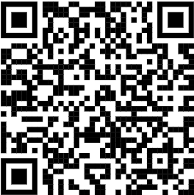
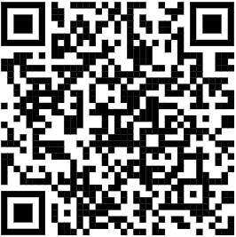
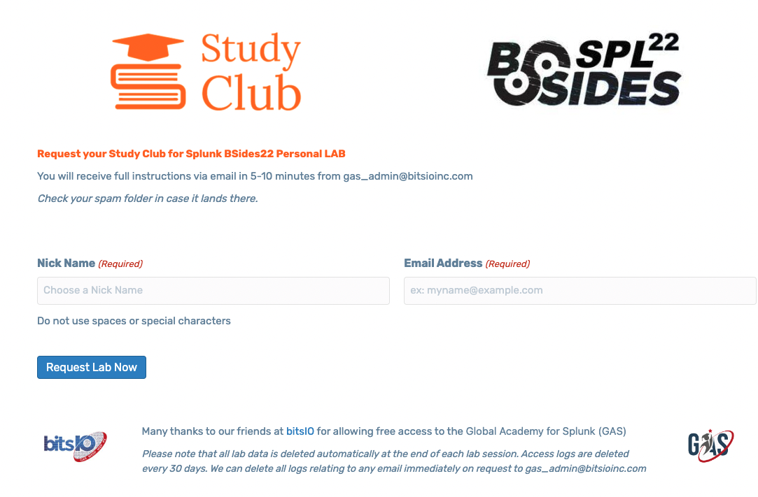
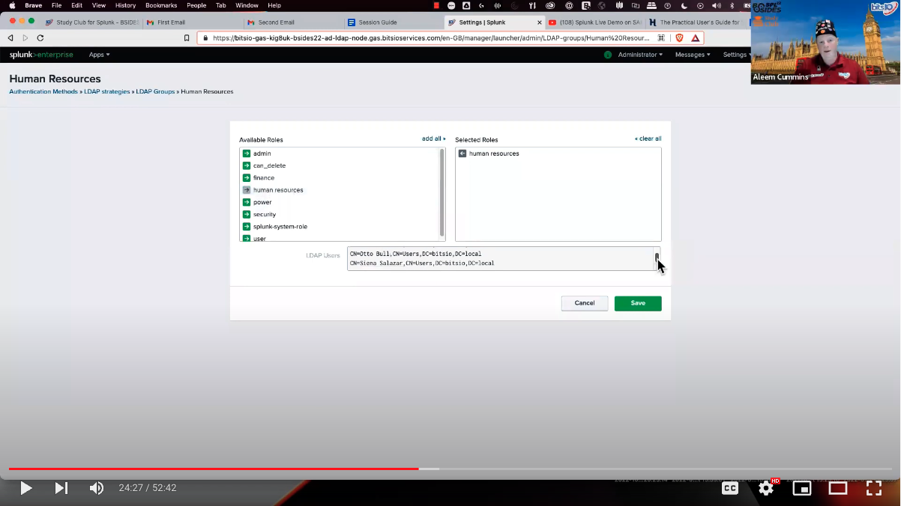
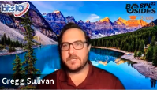


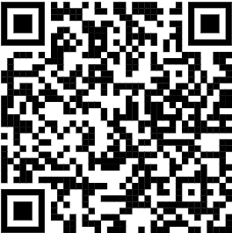


AD & LDAP Hands-on
Step 1 > Request your personal BDSIDES SLP 22 GAS lab environment
Step 2 > Watch session recording and follow along with your lab.
Play, pause and try to suit your pace
http://bsides22.gas.studyclub.community
http://bsides22.video.studyclub.community
Global Academy for Splunk
Global Academy for Splunk
#study-club-for-splunk
http://splunk-slack.studyclub.community

